Slide 1

ALARM ANALYSIS AND GROUPING MANAGEMENT

Slide 2
What we did?
Data Cleaning
Data Analysis
NLP & Clustering
Alarm Grouping
Time – Series Prediction

Slide 3
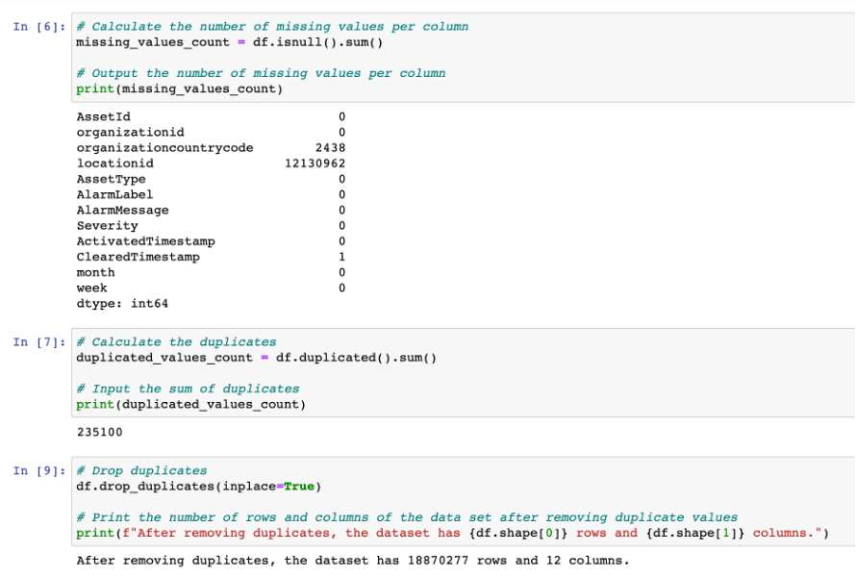
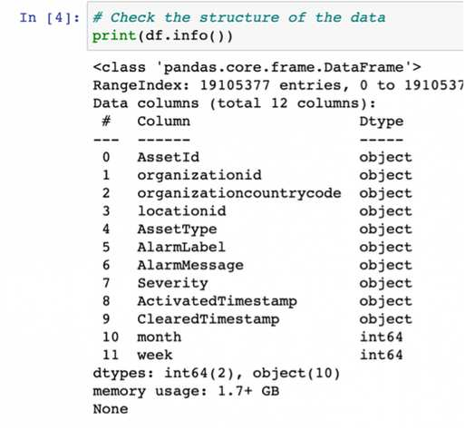
EDA Part
1.Data Cleaning
Checking the data structure Converting timestamps to datetime format
Missing value handling Duplicate value handling

Slide 4
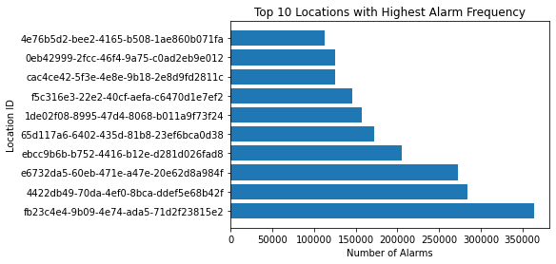
2.Data Analysis
Question 1: How is the frequency of device alarms distributed across different locations?
Top 10 locations with the highest number of alarms.
This can help us determine which locations may need more attention and maintenance to reduce the risk of failure and improve equipment reliability.

Slide 5
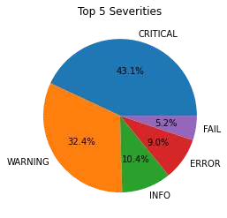
2.Data Analysis
Question 2: What is the distribution of alarm severities ?
A high number of alarms with high severity may indicate a greater risk and potential for serious failures or security problems. Conversely, a low number of high-severity alarms may indicate a stable system or device performance and low risk.

Slide 6
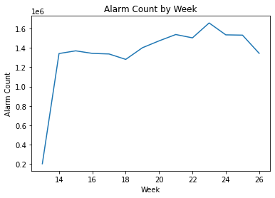
2.Data Analysis
Question 3: What is the relationship between the number of alarms and the number of weeks?
There is a sharp increase in the number of alarms from week 13 to week 14, from 200,000 to about 1.3 million. After 18 weeks from week 14, the number of alarms remained almost unchanged, with a little downward trend, but between weeks 18 and 23, the number of alarms increased further, peaking at 1.7 million in week 23. After that, there was a downward trend until week 26, and the frequency of alarms dropped to 1.4 million in week 26.

Slide 7
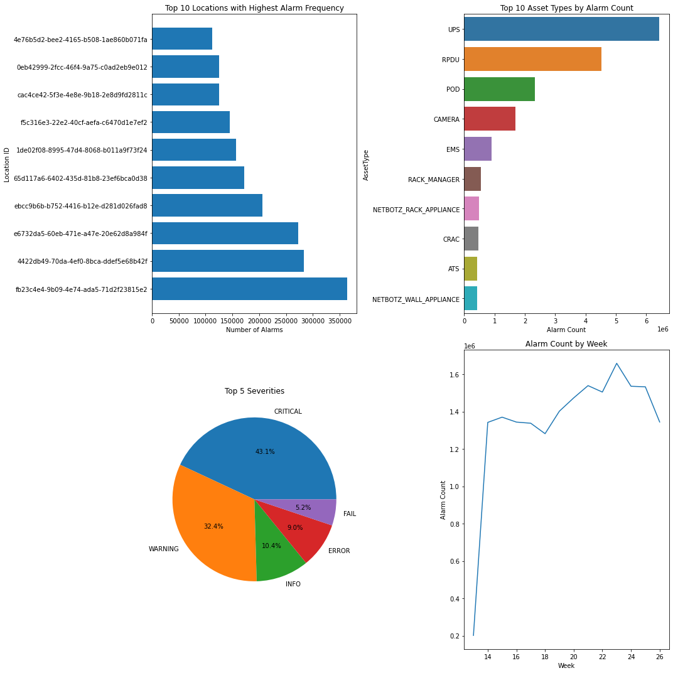
Dashboard
The dashboard we made is about answering four questions about the top 10 locations with the highest number of alarms, the severity of the top 5 alarms, the type of the top 10 alarms, and the distribution of the frequency of alarms per week. The tool used is Python, and the two libraries called are matplotlib and seaborn to achieve a graphical presentation of all our questions in an easy-to-understand way for the audience to understand the information I want to convey. If you have ideas for enhancing our dashboard, we're always open to them, thanks.

Slide 8
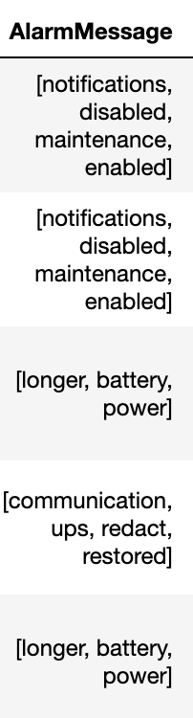
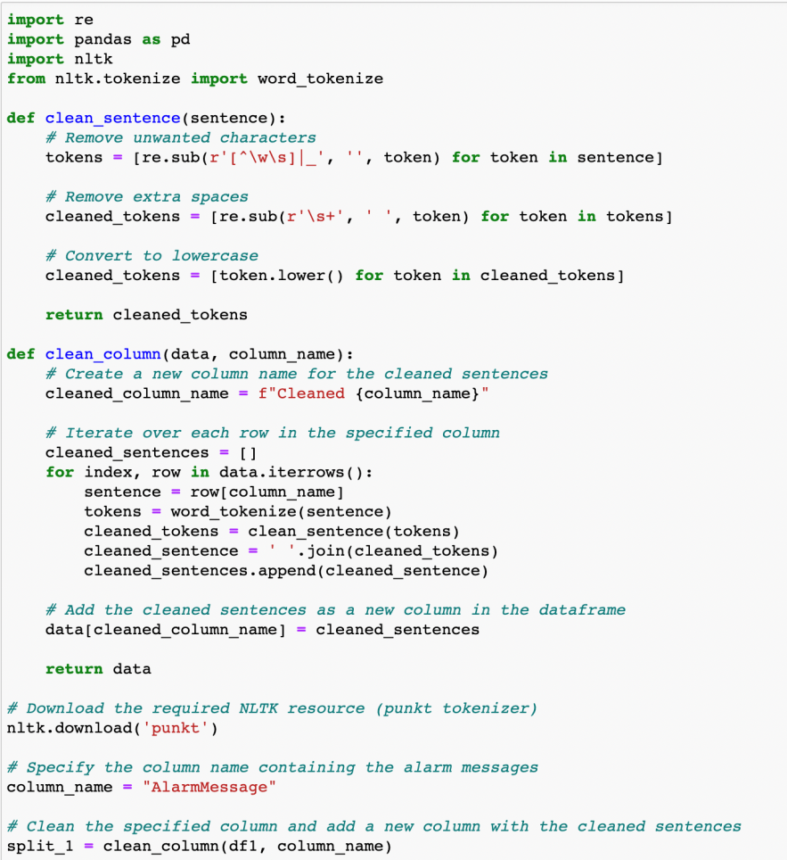
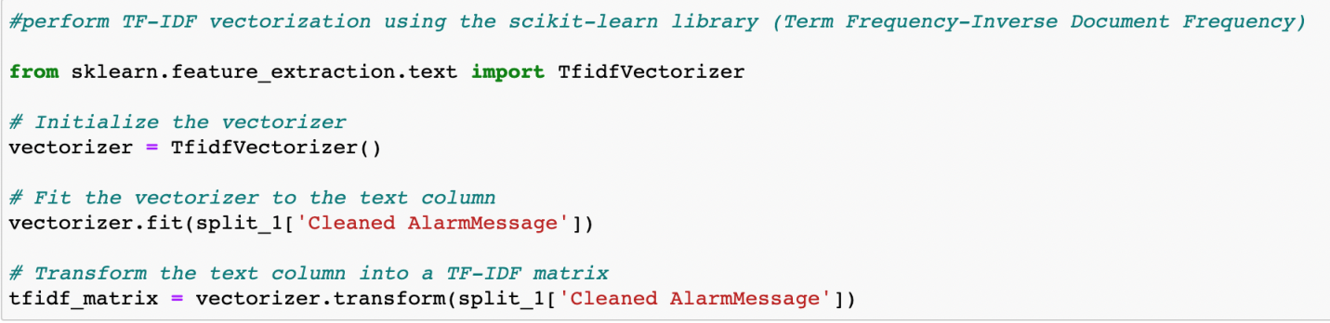
NLP method
Text Preprocessing
TF-IDF(Term Frequency- Inverse Document Frequency) text vectorization processing
Stemming and Lemmatization

Slide 9
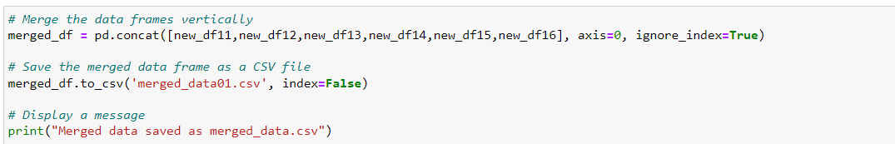
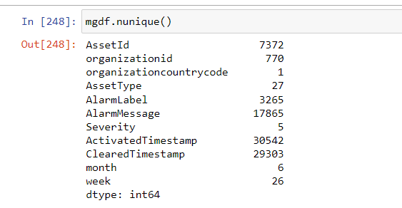

Extracting the unique data for alarm messages column from all the six months data for analysis
This is showing the unique USA data from six months is merged into one single file and resulting data size is shown.

Slide 10
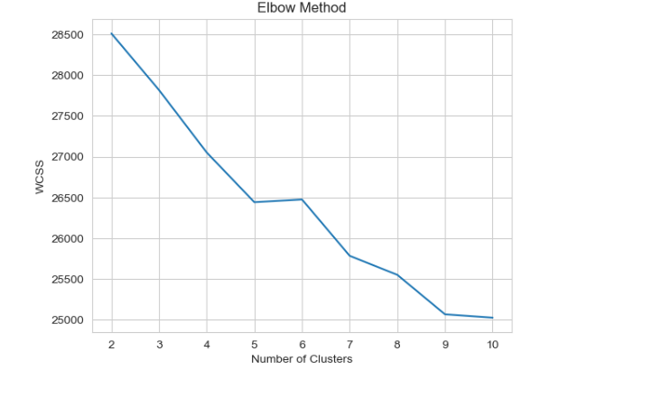
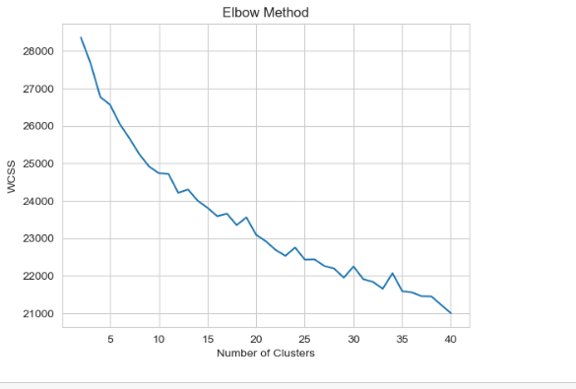
Finding the best number of clusters.
Calculating the WCSS(within clusters sum of squares) base on Elbow method.
We found optimal to be 7 clusters.

Slide 11
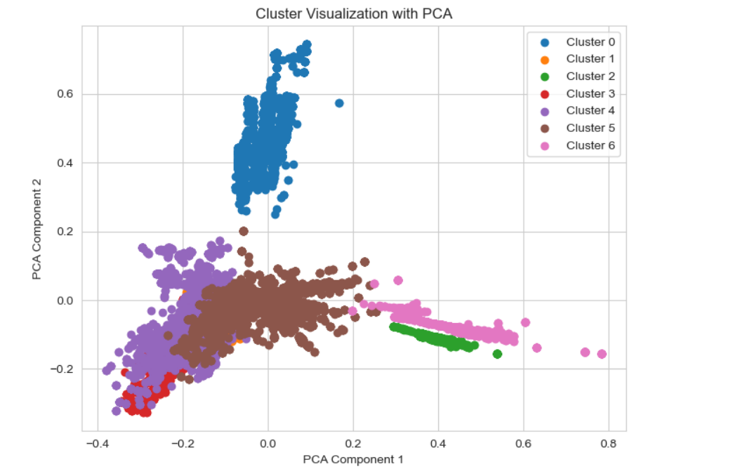
Clustering visualization
We used K means clustering for clustering analysis.
This is how our clustering looks like.
The visualization allows us to observe the cluster structure and identify any patterns or relationships between the data points within and between clusters. It provides an overview of how the clustering algorithm has grouped the data points based on their similarities in the original high-dimensional space, projected onto a two-dimensional space for visualization purposes.

Slide 12
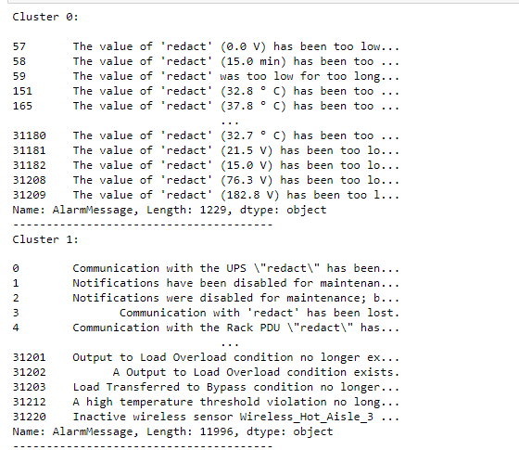
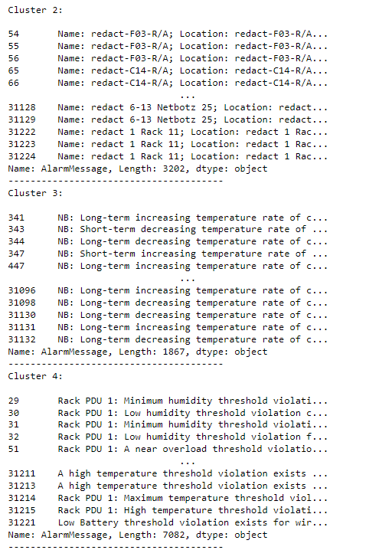
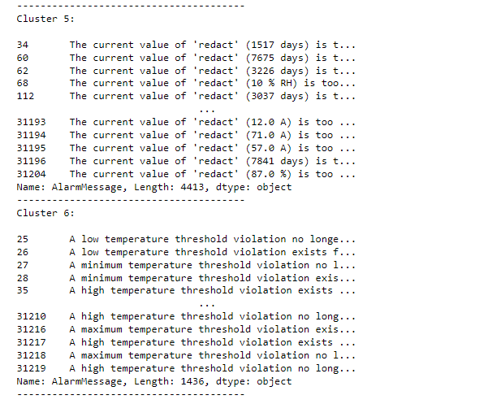
Label the cluster name
Cluster 0: Distribution Module Breaker Open
Cluster 1: Communication and System Status
Cluster 2: Redact Name and Location
Cluster 3: Long-term and Short-term Temperature Rate
Cluster 4: Temperature and Humidity Threshold Violation
Cluster 5: Power and Load Conditions
Cluster 6: Value Threshold Violation

Slide 13
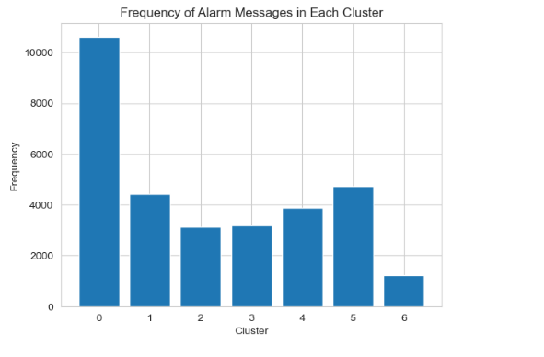
Cluster frequency for the extracted unique dataset
This graph is depicting the cluster number vs the no of observations in each cluster

Slide 14
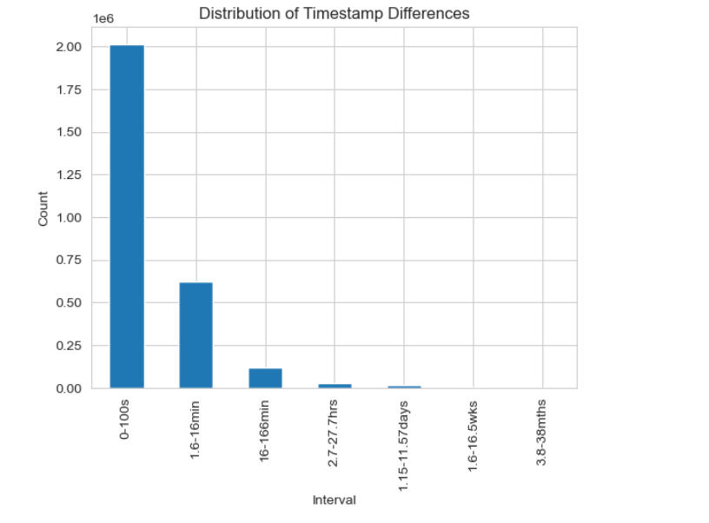
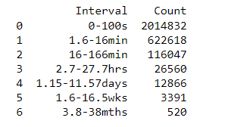
We used time stamps for further grouping analysis for unique dataset
We used the difference between the two time stamps and found the time in seconds. There after we classified the time into intervals for grouping purpose.
Later on we also found time difference for every moth original data.

Slide 15
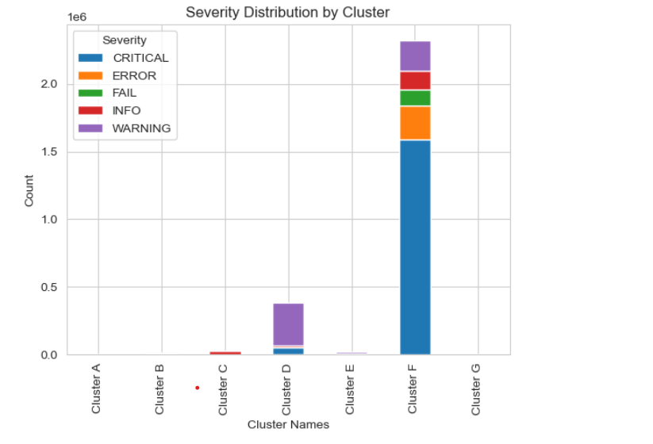
Severity grouping of the month 1for USA data only
This is how the severity graph for the 1st month USA data only comes out.
It seems like there is no clusters for A,B,G clusters. As the data is huge they are of least size, so they got diminished here.

Slide 16
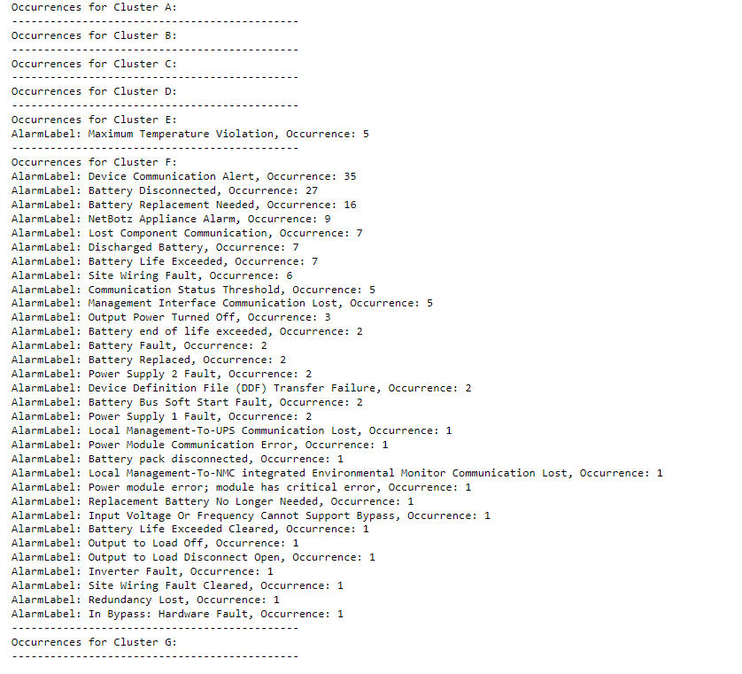







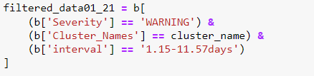

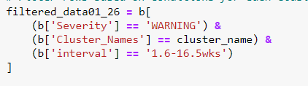

Conditional groupings of the data
Here we are conditional grouping the whole dataset based on 3 conditions. And from this we will know how and how many alarm labels are occuring and repeating for each cluster and time interval.

Slide 17
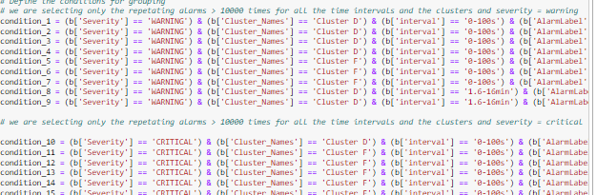
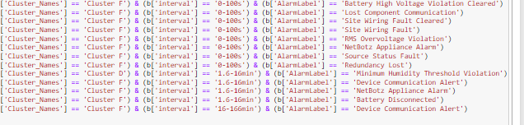
Final grouping of the alarms based on my alarm reduction idea. Conditioning statements for grouping
Our idea is to group the alarm which are repeating more than 10000 times under the severity levels – Warning & Critical, with the clustering and time intervals . Then based on the occurence of the alarm labels we did the conditional statements

Slide 18
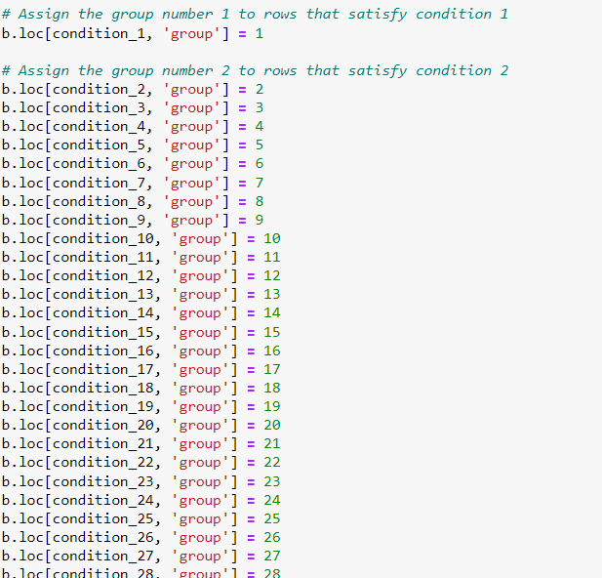
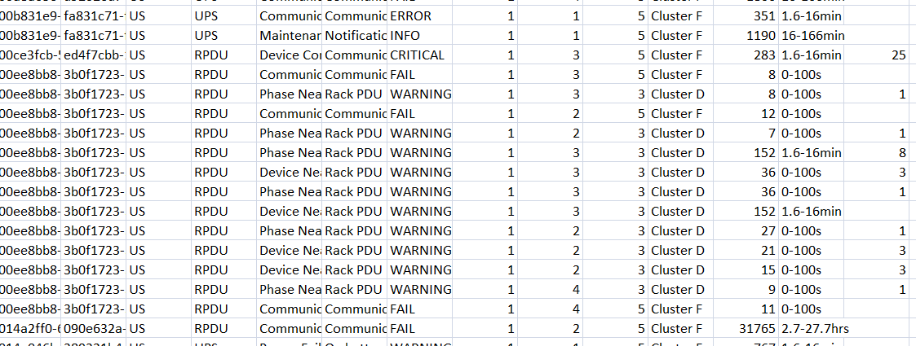
Contd..
Left and right are the grouping statements and grouping in the excel sheet respectively according to the conditions.

Slide 19
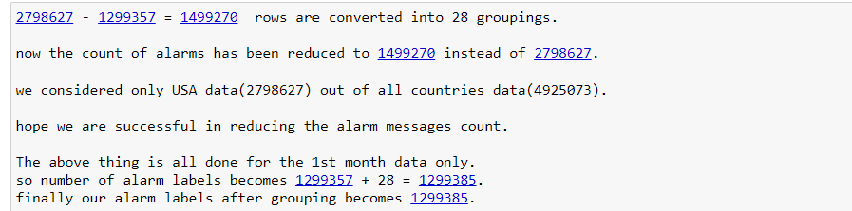
Contd..
Groupings:
Nan values are those which are not grouped, and the remaining numbers from 1 to 28 are the different groupings.
So the 28 groups are counted for 1499270 alarm labels which are grouped and reduced.

Slide 20
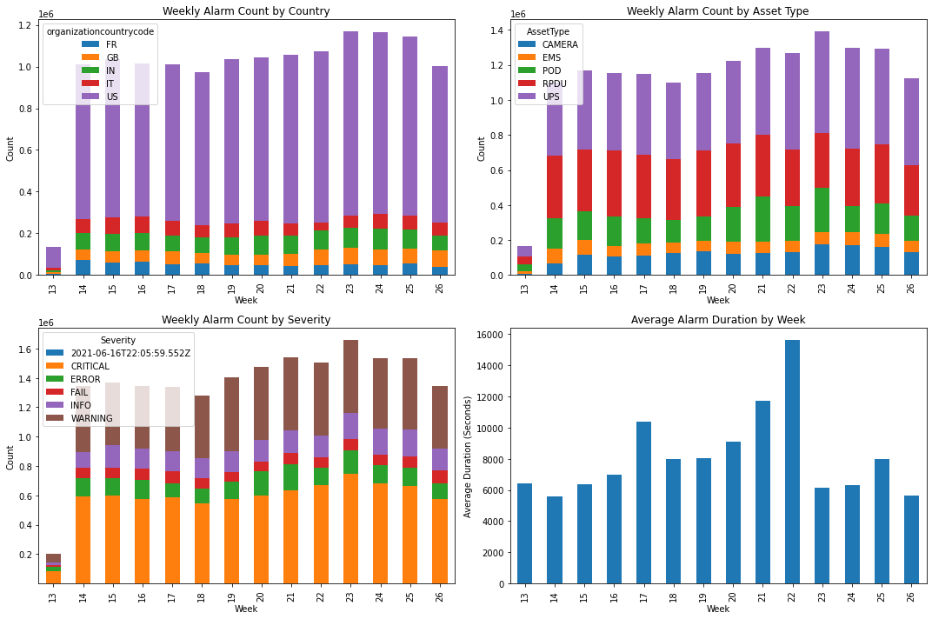
Time-series Dashboard

Slide 21
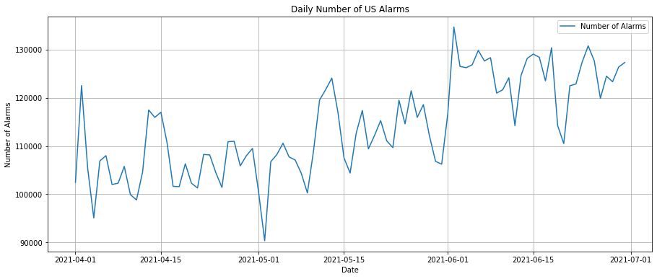
Time-series Predictive object
Based on the feedback from last time, I will make the following adjustments for time series prediction
Go for time series forecasting of the number of alarms based on a specific country, e.g. US
Give up using ARIMA model with poor predictive power and use Exponential Smoothing model instead
Forecast the next 15 days of data

Slide 22

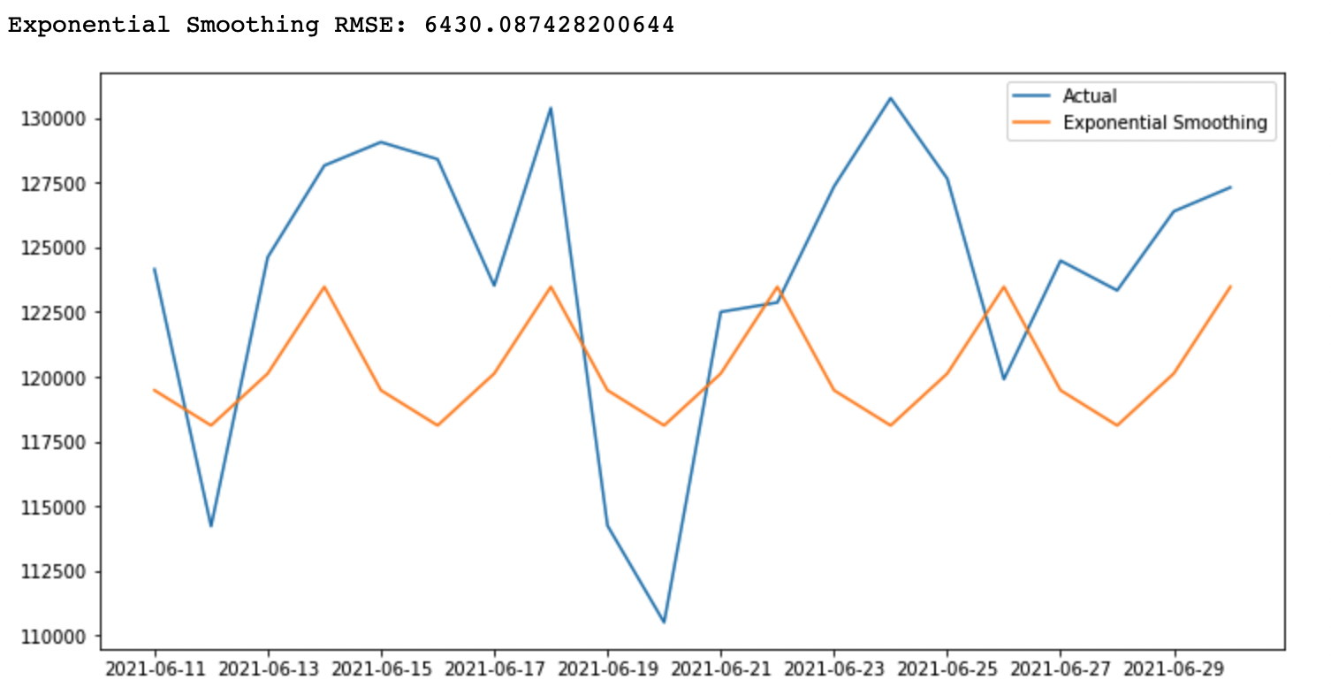
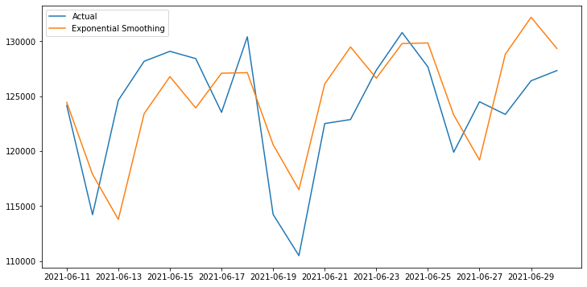
Model optimization
This result indicates that the parameter optimization significantly improves the prediction performance of the model. Specifically, the prediction error of the optimized exponential smoothing model was about 26% lower than that of the pre-optimized exponential smoothing model ((6430.09-4733.39)/6430.09). Then, we used this optimized model to predict the number of alarms in the coming month and visualized the prediction results.

Slide 23
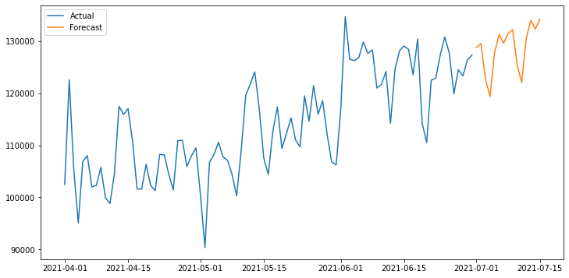
Model prediction
After determining the optimal model, we forecasted the number of alerts in the US region for the first half of July (15 days). The chart shows that the slight upward trend at the end of June is continued and cyclical, which helps us to warn in advance and develop strategies accordingly.
Conclusions and Recommendations:
Our time series forecasting model is very useful for predicting and managing future alert numbers.
By predicting the number of future alarms, we can better understand and predict system behavior and prepare in advance, such as scheduling maintenance personnel in advance and purchasing necessary equipment in advance.
The model also helps us to understand trends and seasonal patterns in the number of alarms, which is also very useful in understanding system behavior and performance.

